Slide 1
Lightweight Multimodal Ensemble for GOLD-Price Forecasting
By: Abhinav Vadhera, Rodrigo Lopez, & Vikyath Naradasi
CSCI 567: Machine Learning
Prof: Victor S. Adamchik, TA: Philipp Eibl
Notes:
Vikyath

Slide 2
TABLE OF CONTENTS
01
02
03
04
Problem Statement
Models
Results
Q&A
Notes:
Vikyath

Slide 3
01
Problem Statement
Notes:
Abhinav

Slide 4

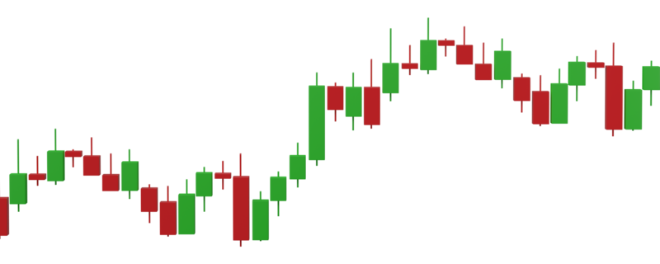
Motivation
Gold volatility surged post-2020, driven by macroeconomic events.
Sensitive to CPI inflation, USD fluctuations, and oil market volatility.
Traders and institutions need short-term forecasts for hedging.
Ideal candidate for multivariate time-series ML prediction.
High market value: even small forecasting improvements offer significant returns
Notes:
Abhinav

Slide 5
Dataset
Collected daily data from Yahoo Finance, Kaggle, & FRED (2010–2025).
Series:
Gold (GC=F),
USD Index (DX-Y.NYB),
Oil (CL=F),
CPI.
Engineered 11 features: returns, moving averages:
(5-day, 20-day), volatility, RSI.
Min-max scaling applied to standardize features (0–1 range).
Sliding-window: 30-day inputs → next-day gold prediction.
Final split: 3045 training samples, 760 validation samples.
Notes:
Abhinav

Slide 6
02
Models
Notes:
Vikyath

Slide 7
A MULTIMODAL APPROACH
BI-GRU
TRANSFORMER
TCN
1-layer, 32 units; captures sequential patterns.
HuggingFace Tiny; attention identifies critical days.
Dilated causal convolutions (3 layers); efficient and fast.
Each model trained individually on identical dataset.
Model diversity ensures complementary strengths/weaknesses.
Allows ensemble to capitalize on differing prediction patterns.
Notes:
Vikyath

Slide 8
Bi-GRU Overview
Bidirectional Gated Recurrent Unit:
Specialized RNN that captures sequential relationships.
Uses gates to control information flow (update/reset gates).
2 GRUs stacked: one processes data forward (past→future), another backward (future→past).
Captures context from both past and future data points.
Ideal for time-series data where both previous and subsequent context matter.
Why did we use Bi-GRU?
Excellent for short-term memory:
remembers key market events.
Lightweight:
few parameters, quick to train.
Naturally handles time-series:
Gold prices strongly dependent on historical context!!
Notes:
Vikyath

Slide 9
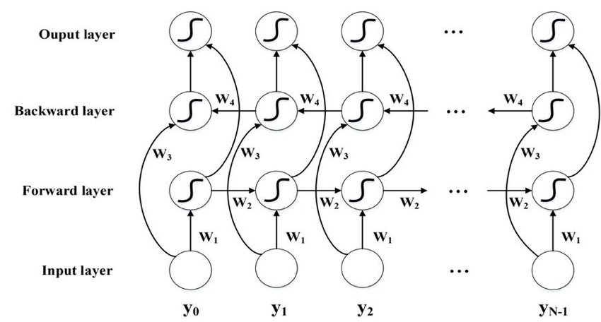
Bi-GRU Overview
Our Bi-GRU Setup
Single-layer Bidirectional GRU.
32 hidden units per direction (forward/backward).
Input:
30-day window of market and indicator features.
Output:
Prediction of gold price (next-day value, scaled).
Notes:
Vikyath

Slide 10
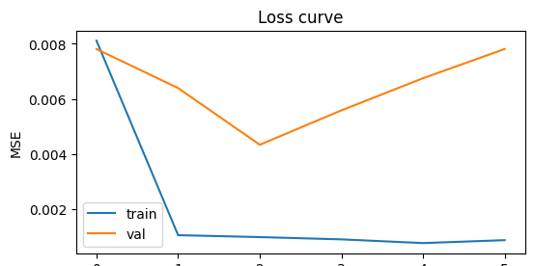
Bi-GRU Results
Provided robust baseline for ensemble fusion = (71% weight in final ridge ensemble)
Time taken to train on T4 GPU = ~290 secs
Best single-model RMSE = 0.067 (scaled)
Bi-Direction accuracy = ~49%
Notes:
Vikyath

Slide 11
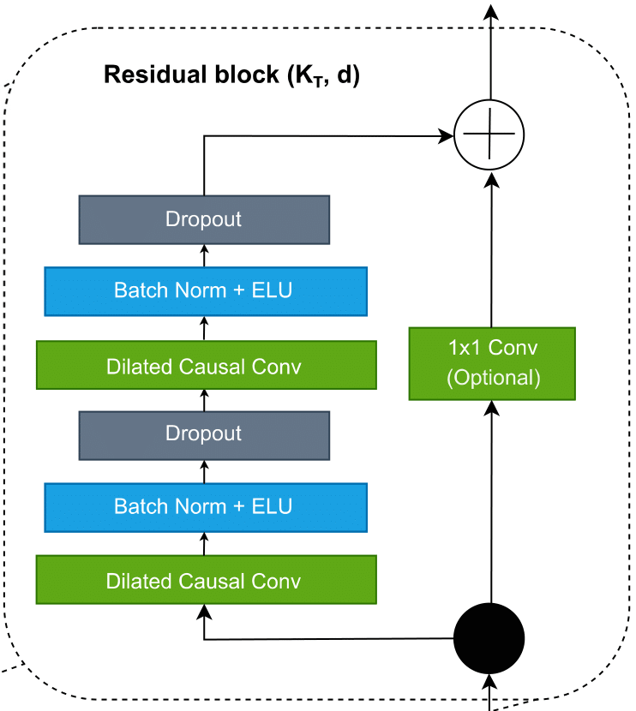
Temporal Convolutional Network (TCN) Overview
TCN Concept:
- CNN adapted for time series prediction
- Processes multiple time steps in parallel (vs sequential RNNs)
- Uses "causal" convolutions - NO future data leakage
Multi-Scale Pattern Detection:
- Dilated convolutions see different time scales simultaneously
- Dilation 1: Daily patterns [day t-2, t-1, t]
- Dilation 2: Weekly patterns [day t-4, t-2, t]
- Dilation 4: Monthly patterns [day t-8, t-4, t]
Key Advantages:
- Faster training: Parallel processing
- Long memory: Large receptive field
- Interpretable: Can visualize learned filters
- Causal: Respects temporal order
Notes:
Rodrigo: Our implementation processes 30-day windows of 11 features - gold price, USD index, oil prices, and various technical indicators - and outputs a single next-day gold price prediction. The model has about 37,000 parameters, making it lightweight and efficient.

Slide 12
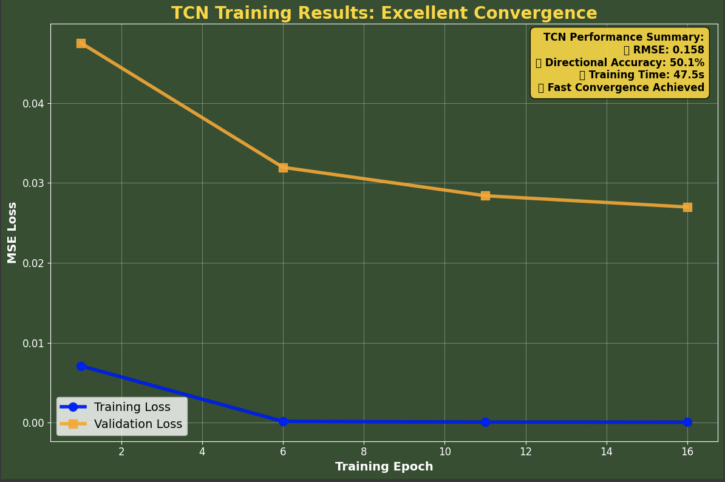
TCN Results
Model Performance:
- RMSE: 0.158 (scaled data) - Excellent precision
- Directional Accuracy: 50.1% - Baseline signal for ensemble
- Training Time: ~47.5 seconds ⚡ - 5x faster than BiGRU
- Parameters: 36,641 - Lightweight & efficient
Notes:
Rodrigo

Slide 13
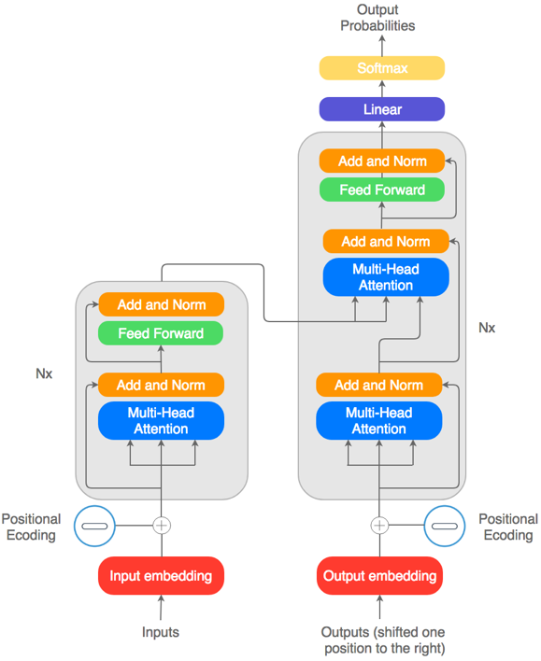
Transformer Model
Data Preparation: TimeSeriesDataSet with encoder length 30, prediction length 1 (feature dim = 11)
Core Model: PyTorch Forecasting’s TemporalFusionTransformer
Hidden size: 64, Attention heads: 4
Dropout: 0.1, Learning rate: 0.001
Custom Model: MVTransformerWithAttn
Input projection → d_model=128, n_head=8,
3 encoder layers
Pooling & Dense head for regression
Training & Optimization: PyTorch Lightning Trainer (epochs=10, AdamW, MSELoss)
Notes:
Abhinav

Slide 14
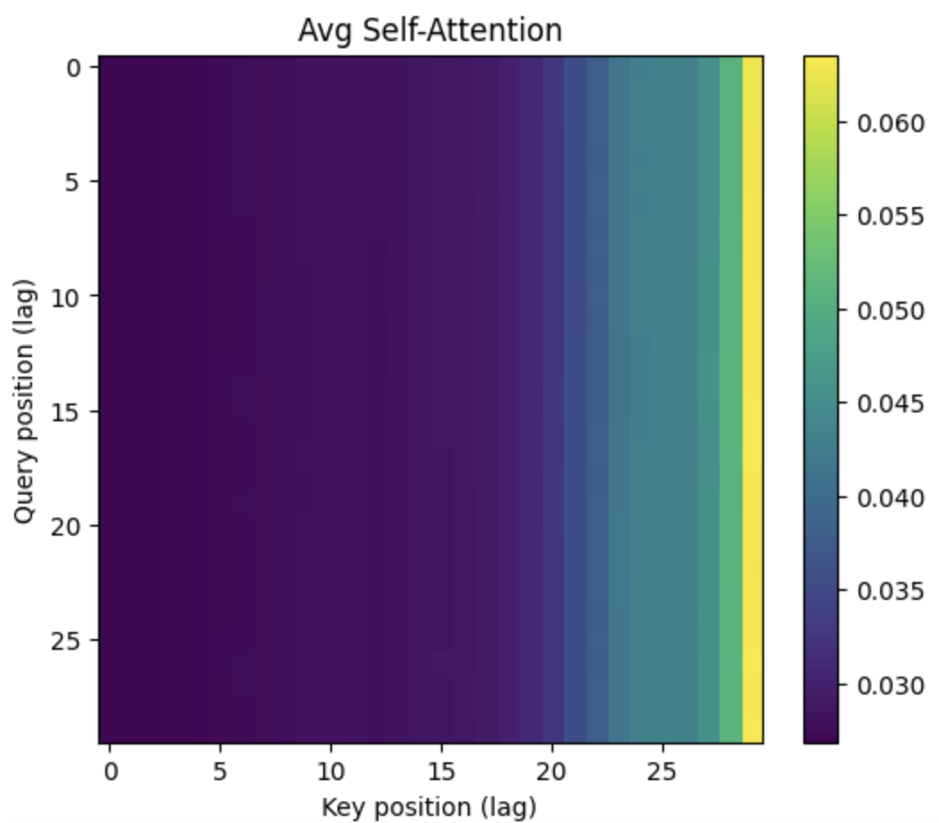
Results
# Params to train = ~398k
Time taken to train on T4 GPU = ~50 secs
Validation RMSE = 0.148
Bi-Direction accuracy = 52.7 %
Notes:
Abhinav

Slide 15
Key Observations
Magnitude vs. direction trade-off:
Bi-GRU wins on RMSE, Transformer on Daily Avg.
Ridge focuses on minimizing squared error, so it leans heavily on Bi-GRU and improves RMSE but not Daily Avg.
TCN under-performed in comparison:
RMSE > 0.8 indicates a scaling bug or label mis-alignment. It still adds slight directional signal but hurts any simple average.
RMSE-weighted fusion struggled:
Because TCN’s RMSE is an order of magnitude larger, the 1/RMSE weighting assigns ~100 % weight to Bi-GRU—identical result.
Notes:
Rodrigo

Slide 16
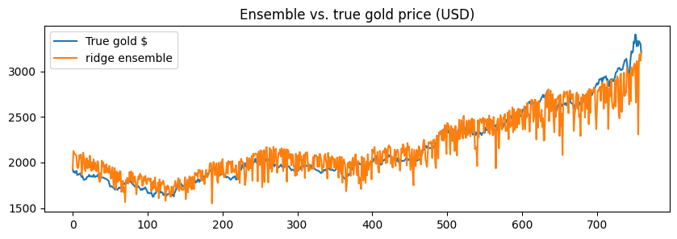
Ensemble Results
Notes:
Rodrigo

Slide 17
Ensemble Results
Benchmark group | Typical setup & metric | What they get | Our result
Naïve baseline(“tomorrow = today”) | RMSE on scaled prices | 0.09 – 0.10 | 0.067
Academic papers on gold-price forecasting(LSTM / GRU with tech indicators) | RMSE on unscaled USD prices | 110–200 USD (≈ 0.07–0.12 when scaled to our range) | ≈ 150 USD (0.067 scaled)
Modern SOTA research papers (Temporal Fusion Transformer, Informer, TFT + macro/news) | Directional accuracy (DA) 55–65 %RMSE 0.05–0.06 (scaled) | 58% DA 0.050 RMSE | 53 % DA 0.067 RMSE
Quant-fund intraday models (thousands of covariates, alt-data) | Hit-rate 50.5–54 % on high-frequency returns; edge proven via Sharpe | 55-60% | 53 % DA at daily horizon
Commodity banks / research desks (ARIMA + macro judgment) | 1-month MAPE ≈ 2–3 % | ~65–100 USD error | ~4.5 % MAPE (~150 USD)
Notes:
Vikyath

Slide 18
What do our results means?
Why our numbers are quite respectable, despite accuracy!
Tiny feature set, no news sentiment:
We used only four market series + economic indicators.
Big financial firms add FX crosses, gold ETF flows, Fed statements, Wall Street insider info, Twitter/Bloomberg sentiment, etc., to shave the extra few RMSE points.
They also have Billions of $’s in budget
Ultra-light models:
Single-layer Bi-GRU & HF-Tiny weights (~0.5 M params) trained in 5% of the time.
Cutting-edge transformers run tens of layers and hours of hyper-search.
Notes:
Vikyath

Slide 19
04
Q&A
Notes:
Vikyath

Slide 20
THANK YOU
Abhinav Vadhera
vadhera@usc.edu
Rodrigo Lopez
wrlopez@usc.edu
Vikyath Naradasi
naradasi@usc.edu
Do you have any questions?
Please keep this slide for attribution
Notes:
Vikyath

